Slide 1
CPSA 4 Corners Initiative 2018

Slide 2
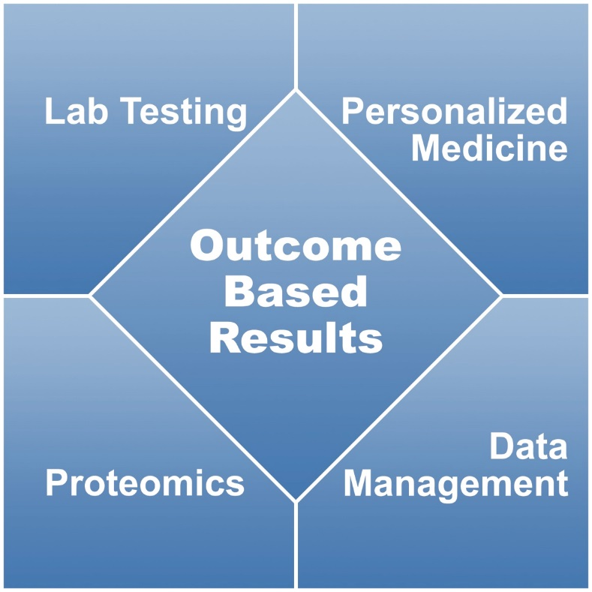
Through collaborative scientific discourse, develop integrated processes to guide development of cutting-edge technology and drive its translation directly into the clinic or home to improve personal health and wellbeing

Slide 3
Stakeholders in Healthcare
Pharma/Researchers
Laboratories
Physicians
Patients
Insurers
Government

Slide 4
Evolving Themes/CPSA
Personalized Medicine
Biomarker profiling, advanced diagnostics
Development of more effective therapies
Preventative Healthcare
Longitudinal studies
Early detection and intervention
Wellness programs
Patient Empowerment
Access to health information
Informed choices

Slide 5
Convergence Point
Biomarker Data to Support Early Drug Development (NIH/Public Databases, Company Databases)
Clinical Outcomes and Safety Data (Transcelerate/BioCelerate)
Data to drive Physician Practice Guidelines (Meta-analyses and Evidence-Based Reviews)
Patient Access to Health Data (Credible data sources)
Data to Support Reimbursement Policies (Meta-analyses and Evidence-Based Reviews)
Data Aggregation
Stakeholder decisions are almost always based on use of aggregated data

Slide 6
Data Aggregation
Population Models aggregate clinical chemistry test results from multiple labs from multiple countries
Population Model
CL1
CL2
CL3
CL4
CL5
CL6
CL7
CL8
CL9
CL10
CL12
Different labs use different analyzers
May have different normal ranges
Identical tests in different labs known to give different results
Data formats will differ
Data management groups charged with aggregating need result and normal range
Statisticians need to work with the jumble to normalize and then extract statistical differences

Slide 7
Data Aggregation
Transcelerate* is looking to create ‘data lakes’ with de-identified study data
Test 1
CL1
CL2
CL3
CL4
CL5
CL6
CL7
CL8
CL9
CL10
CL12
Test 2
CL1
CL2
CL3
CL4
CL5
CL6
CL7
CL8
CL9
CL10
CL12
What if they were to try it with PD-L1 data?
At least 4 tests with different antibody detection reagents
Comparative assessments show they are not equal
Test 4
CL1
CL2
CL3
CL4
CL5
CL6
CL7
CL8
CL9
CL10
CL12
Data Lake
Test 3
CL1
CL2
CL3
CL4
CL5
CL6
CL7
CL8
CL9
CL10
CL12
*Pharma consortia for improved drug development

Slide 8
How can standardization can be accomplished within Pharma?
STEP 1: Identify key stakeholders

Slide 9
How can standardization can be accomplished within Pharma?
STEP 2: Organize an independent standardization oversight committee
Define the measurand
Define mandatory characteristics of the primary reference material and it’s value assignment
Define analytical performance requirements of the reference method
Agree on the reference method procedure
Identify a network of independent laboratories performing the reference method
Develop a common secondary reference material or human sample panel (value assignments traceable to common to the primary reference material) and reference method
Implement routine survellaince of calibration traceability

