Slide 1
Patient Centric Sampling Interest Group
Achievements and Next Steps
Erwin Berthier – Tasso
Soren Therkelsen – Qurasense
Joe Siple – New Objective
Neil Spooner – Spooner Bioanalytical Solutions

Slide 2
Patient Centric Sampling Interest Group
Founded at CPSA USA 2017
Thank-you Mike Lee
Free to join
>90 members
>50 different organisations
CROs, biotech, pharma, device innovators, instrument vendors, consumable vendors, consultancies, etc
Collaborate across organisations in non-competitive areas of mutual interest
Workplace platform – Facebook product
Sharing of documents
Conversations
Thank-you Trajan Scientific and Medical
Want to join?
Write to neil@spoonerbioanalytical.co.uk

Slide 3
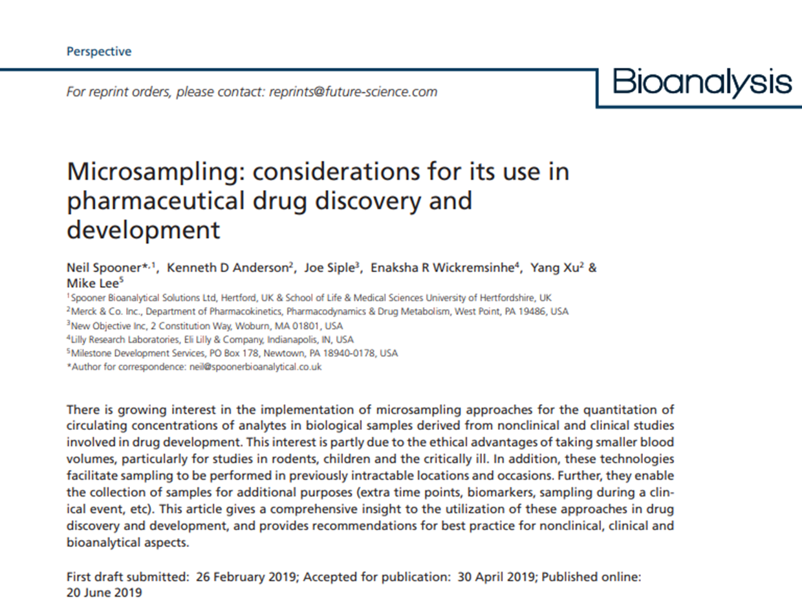

Slide 4
Current Activities - Standardisation
Building an industry standard
CLSI
IVD Industry Connectivity Consortium
Fast Healthcare Interoperability Resources - FHIR
“Standardization of metadata associated with the use of patient centric blood sampling devices for the quantitative determination of circulating analyte concentrations”
Activities led by:
Søren Therkelsen, Neil Spooner, Greg Nagy, Tim Richards, Enaksha Wickremsinhe, Pawanbir Singh, Cory Zuehlsdorf, Florian Lapierre

Slide 5
Current Activities – Acceptance
Facilitating the broad acceptance of patient centric sampling technologies and pathways to their implementation
Public, Scientific community, Medical community, Legislators, Payers, Regulators, Media, etc…….
Building external facing website
Thank-you Future Science
Activities led by:
Florian Lapierre, Jinming Xing, Tim Richards, Neil Spooner, Kayte Parlevliet

Slide 6
Future Additional Activities
Independent clinical trial?
Other activities?

Slide 7
Want to Join the PCSIG?
Write to
neil@spoonerbioanalytical.co.uk

